Slide 1
Data driven decision making with Optimization: lessons from the industry
Grenoble Data Science Meetup
Georgios Balikas
Sept 2025

Slide 2
Agenda
Intro
How we use Optimization at Kelkoo
Simple problems
Code
Conclusion

Slide 3


Passionate about Machine Learning:
Information Retrieval
NLP
Forecasting and Optimization
Currently at Kelkoo Group
Community contributor:
Academic and industry conferences
Grenoble Data Science Meetup
Some open source contributions

Slide 4
Data driven decision making with Optimization: lessons from the industry

Slide 5
Linear & Mixed Integer Linear Programming
It’s about finding the best solution to a problem, under some constraints
Linear Optimization:
Continuous decision variables
Maximization/Minimization
Constraints are inequalities
Fast, scalable, approximate

Slide 6
Linear & Mixed Integer Linear Programming
It’s about finding the best solution to a problem, under some constraints
Linear Optimization
Mixed Integer Linear Optimization:
Some decision variables are integers or binary
Expressive, realistic but harder

Slide 7
At Kelkoo, we do traffic allocation and price optimization
Amazon
Google
Darty
Bing
Traffic
Optimizer
Fnac
Kelkoo
Courir
…
Merchants
Publishers
40 countries

Slide 8
The problem we are trying to solve
Maximize (a set of business KPIs)
so that we satisfy our collaborators
and our shareholders
Decision variables:
Traffic allocation: mostly binary
Pricing: mostly float
Very complex pre-processing of past data to fill the holes

Slide 9
A simplified version
You make two products:
Product A (Orange Juice)
Product B (Lemon Juice)
Resources:
Each glass of A uses 2 lemons + 1 cup sugar
Each glass of B uses 1 lemon + 2 cups sugar
At most 10 lemons and 8 cups sugar.
You can’t make negative quantities.
Profit per unit:
A → 3€
B → 2€
How to maximize your profit?

Slide 10
A simplified version
You make two products:
Product A (Orange Juice)
Product B (Lemon Juice)
Resources:
Each glass of A uses 2 lemons + 1 cup sugar
Each glass of B uses 1 lemon + 2 cups sugar
At most 10 lemons and 8 cups sugar.
You can’t make negative quantities.
Profit per unit:
A → 3€
B → 2€
How to maximize your profit?
Let x₁: number of orange juice
Let x₂: number of lemon juice
max 3 * x₁ + 2 * x₂
2*x₁+x₂ ≤ 10
x₁+2*x₂ ≤ 8
x₁>=0, int
x₂>=0, int
Objective Function
Constraints
Decision Variables,
Non-neg. constraints

Slide 11
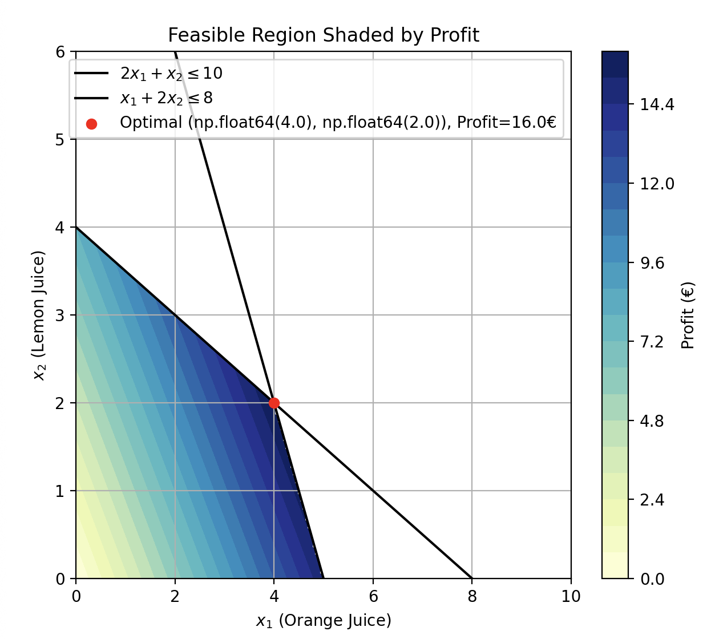
A visual representation of the problem
Let x₁: number of orange juice
Let x₂: number of lemon juice
max 3 * x₁ + 2 * x₂
2*x₁+x₂ ≤ 10
x₁+2*x₂ ≤ 8
x₁>=0, int
x₂>=0, int

Slide 12
A simplified version
Business
Math Formulation
Solvers
You make two products:
Product A (Orange Juice)
Product B (Lemon Juice)
Resources:
Each glass of A uses 2 lemons + 1 cup sugar
Each glass of B uses 1 lemon + 2 cups sugar
At most 10 lemons and 8 cups sugar.
You can’t make negative quantities.
Profit per unit:
A → 3€
B → 2€
How to maximize your profit?
Let x₁: number of orange juice
Let x₂: number of lemon juice
max 3 * x₁ + 2 * x₂
2*x₁+x₂ ≤ 10
x₁+2*x₂ ≤ 8
x₁>=0, int
x₂>=0, int
Objective Function
Constraints
Decision Variables,
Non-neg. constraints

Slide 13
Demo - iterations

Slide 14
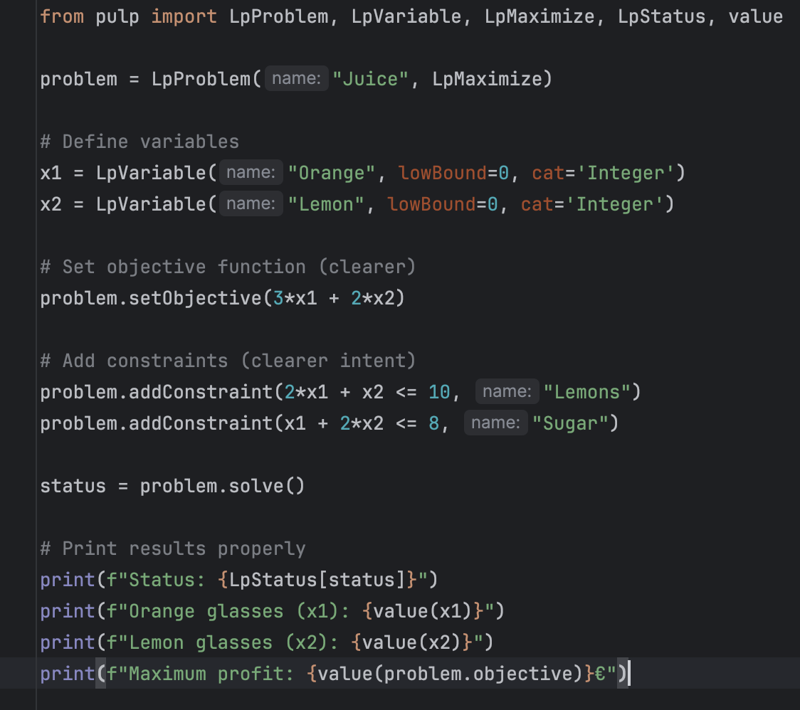
Coding
PuLP: Python Unstructured Linear Programming, a modeling framework
Let x₁: number of orange juice
Let x₂: number of lemonade juice
max 3 * x₁ + 2 * x₂
2*x₁+x₂ ≤ 10
x₁+2*x₂ ≤ 8
x₁>=0, int
x₂>=0, int

Slide 15
A simplified version with a twist
You make two products:
Product A (Orange Juice)
Product B (Lemon Juice)
Resources:
Each glass of A uses 2 lemons + 1 cup sugar
Each glass of B uses 1 lemon + 2 cups sugar
At most 10 lemons and 8 cups sugar.
You can’t make negative quantities.
Setting up a production line costs 3€
Profit per unit:
A → 3€
B → 2€
How to maximize your profit?

Slide 16
A simplified version with a twist
You make two products:
Product A (Orange Juice)
Product B (Lemon Juice)
Resources:
Each glass of A uses 2 lemons + 1 cup sugar
Each glass of B uses 1 lemon + 2 cups sugar
At most 10 lemons and 8 cups sugar.
You can’t make negative quantities.
Setting up a production line costs 3€
Profit per unit:
A → 3€
B → 2€
How to maximize your profit?
Let x₁, x₂: number of orange and lemon juice
Let y₁, y₂: binary dec. variables per prod. line
max 3*x₁ + 2 *x₂ – 3*y₁ – 3*y₂
2*x₁+x₂ ≤ 10
x₁+2*x₂ ≤ 8
x₁ ≤ M*y₁, x₂ ≤ M*y₂
x₁>=0, x₂>=0, y₁,y₂ = {0,1}
Big-M method, links binary
with cont. variables

Slide 17
Demo again

Slide 18
When to use these techniques
Predict-then-optimize
Resource allocation, combinatorial problems
Limited resources, competing objectives, constraints
Clear, quantifiable objectives
The problems feels like “Maximize XYZ”
When small improvements can have sizeable impact
Otherwise, heuristics could work fine

Slide 19
Lessons learned
A very flexible and scalable framework, with great modeling power.
Allows for translating (complex) business problems to solutions.
A lot of effort goes to data preparation
The model, in most cases, is not that complex at the end
Garbage in, garbage out
Counter-intuitive behaviour
Designing a model in paper vs running it
Tooling to allow for quick iterations
Explainability
Especially with a lot of Big-M types of variables
Start simple

Slide 20
